Slide 1

Team 4
Project 2
Employee Attrition Analysis
Group Members:
Elvis Tse
Irene Lau
Darren Shum
Tracy Cheung

Slide 2
Content
Content
Purpose
Data EDA
Python
Tableau
ML
Conclusion
PART 1
PART 2
PART 3
PART 4
PART 5

Slide 3


PART 1
1
Part 1
Introduction

Slide 4

Introduction
Dataset : Attrition Report
Source : Kaggle
Purpose : Employee Analysis
Aims:
What factors will induce an attrition?
What reasons employee will change their job?
What actions can do to deal with this situation?
Data source : https://www.kaggle.com/datasets/whenamancodes/hr-employee-attrition?tags=13208-Data+Visualization&page=2

Slide 5

What is attrition ?
Attrition is the departure of employees from the organization for any reason (voluntary or involuntary), including resignation, termination, death or retirement.
What cost will it brings to the company ?
loss in institutional knowledge
drop in productivity
increase in hiring and training costs

Slide 6
Data Description
Data Description
Attribute | Data Type | Description
Age | Numerical | Age 18-60
Attrition | Categorical | Yes/ No
BusinessTravel | Categorical | Travel_Frequently/ Travel_Rarely/ Non-Travel
Department | Categorical | Sales/ Research & Development/ Human Resources
DistanceFromHome | Numerical | 1-29
Education | Categorical | 1 'Below College' 2 'College' 3 'Bachelor' 4 'Master' 5 'Doctor'
EducationField | Categorical | Life Sciences/ Medical/ Maketing/ Technical Degree/ HR/ Other
EmployeeCount | Numerical | 1
EnvironmentSatisfaction | Categorical | 1 'Low' 2 'Medium' 3 'High' 4 'Very High'
Gender | Categorical | Male/ Female
JobLevel | Categorical | 1-5
JobRole | Categorical | Manager/ Human Resources/ Scientist/ Technician/ Director/ Representative

Slide 7
Data Description
Data Description
Attribute | Data Type | Description
JobSatisfaction | Categorical | 1 'Low' 2 'Medium' 3 'High' 4 'Very High'
MaritalStatus | Categorical | Single/ Married/ Divorced
MonthlyIncome | Numerical | 1,000 - 20,000
NumCompaniesWorked | Numerical | The no. of companies that the employee worked before
OverTime | Categorical | Yes/ No
PercentSalaryHike | Numerical | 11-25
PerformanceRating | Categorical | 1 'Low' 2 'Medium' 3 'High' 4 'Very High'
TotalWorkingYears | Numerical | 0-31
TrainingTimeLastYears | Numerical | 0-6
YearsAtCompany | Numerical | 0-40
YearsInCurrentRole | Numerical | 0-18
YearsSinceLastPromotion | Numerical | 0-15
YearsWithCurrManager | Numerical | 0-17

Slide 8
PART 2
2
PART 2
Python EDA

Slide 9
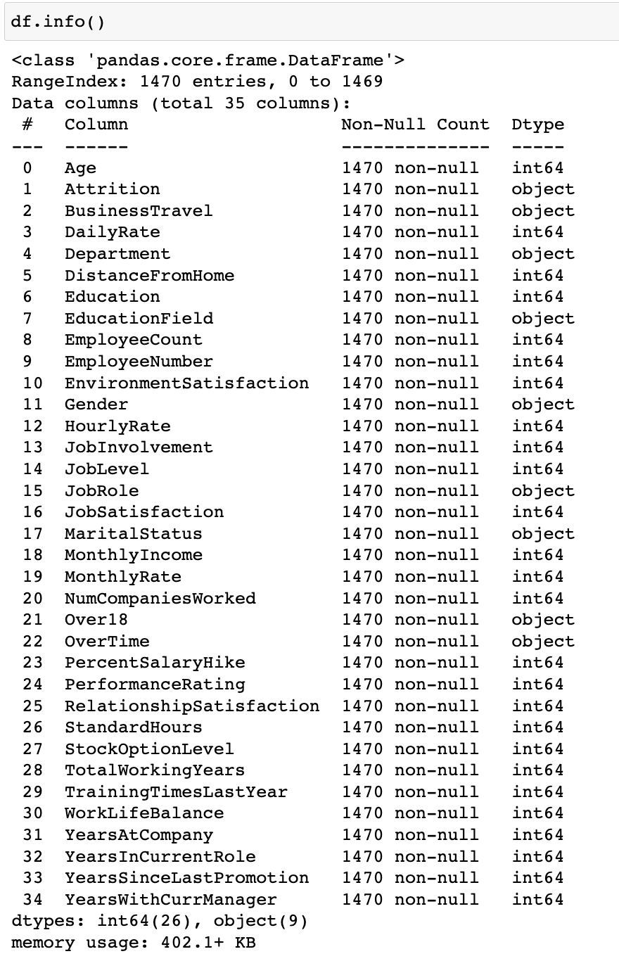


Data Understanding
Value of dropped columns
EmployeeCount = 1
Over18 = Yes
StandardHours = 80
EmployeeNumber = Employee ID
No Null Value

Slide 10

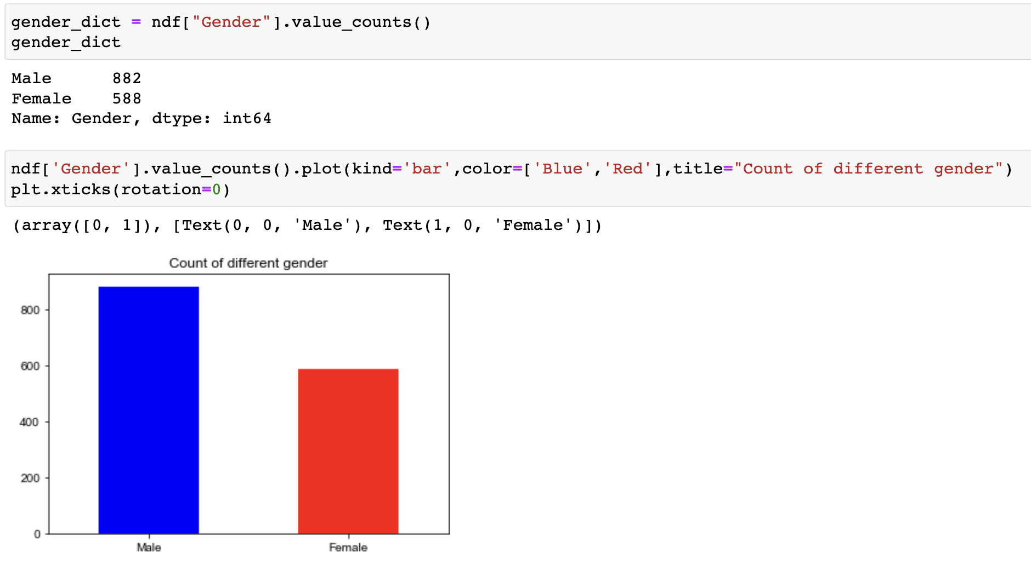
Pandas
Respondents
60% Male / 40% Female

Slide 11
PART 3
3
PART 3
Employee Attrition Analysis

Slide 12
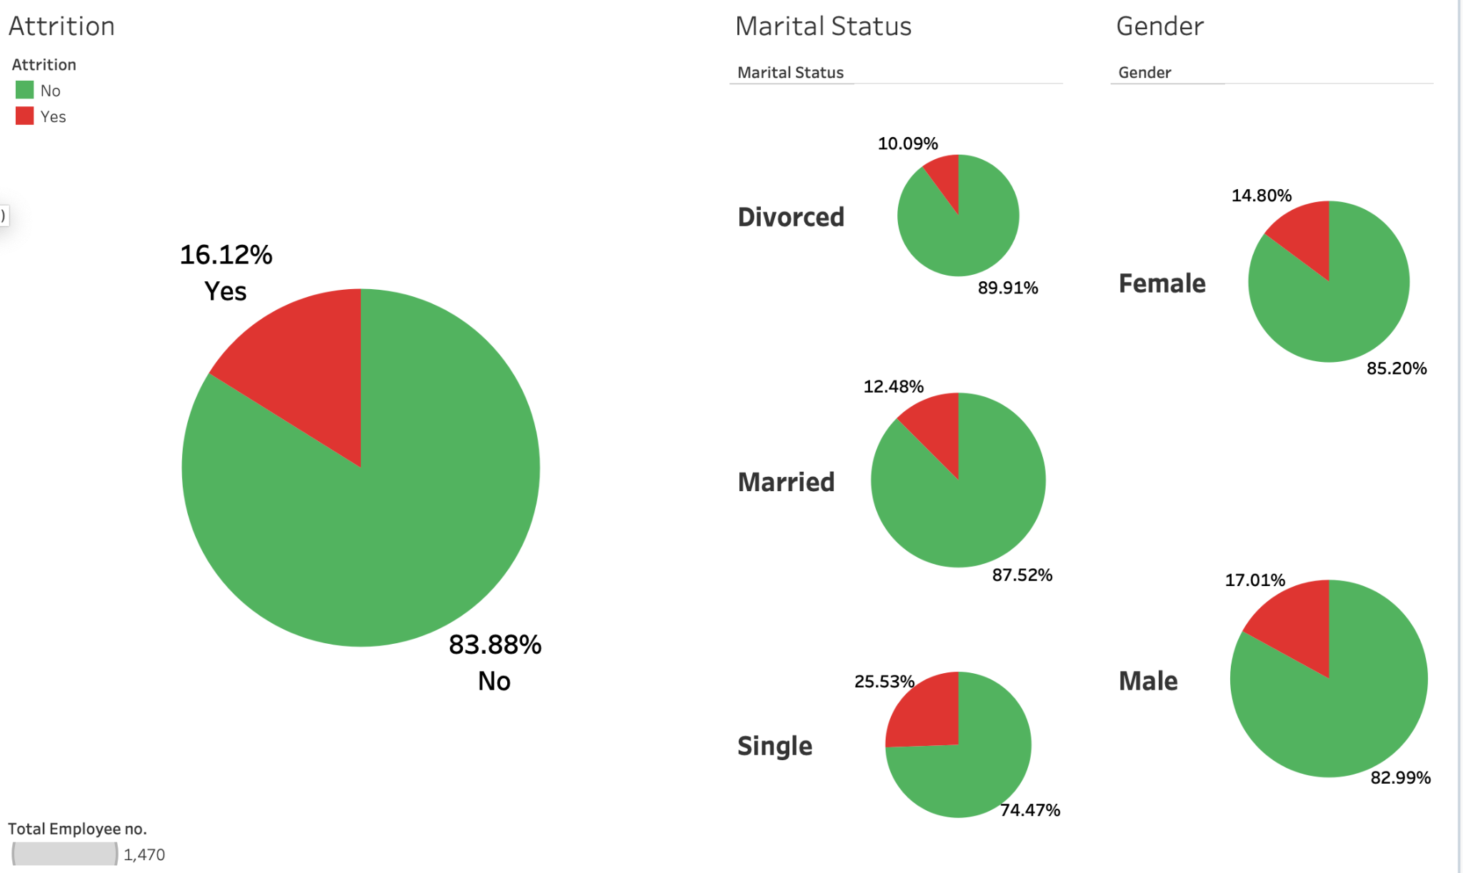

Slide 13
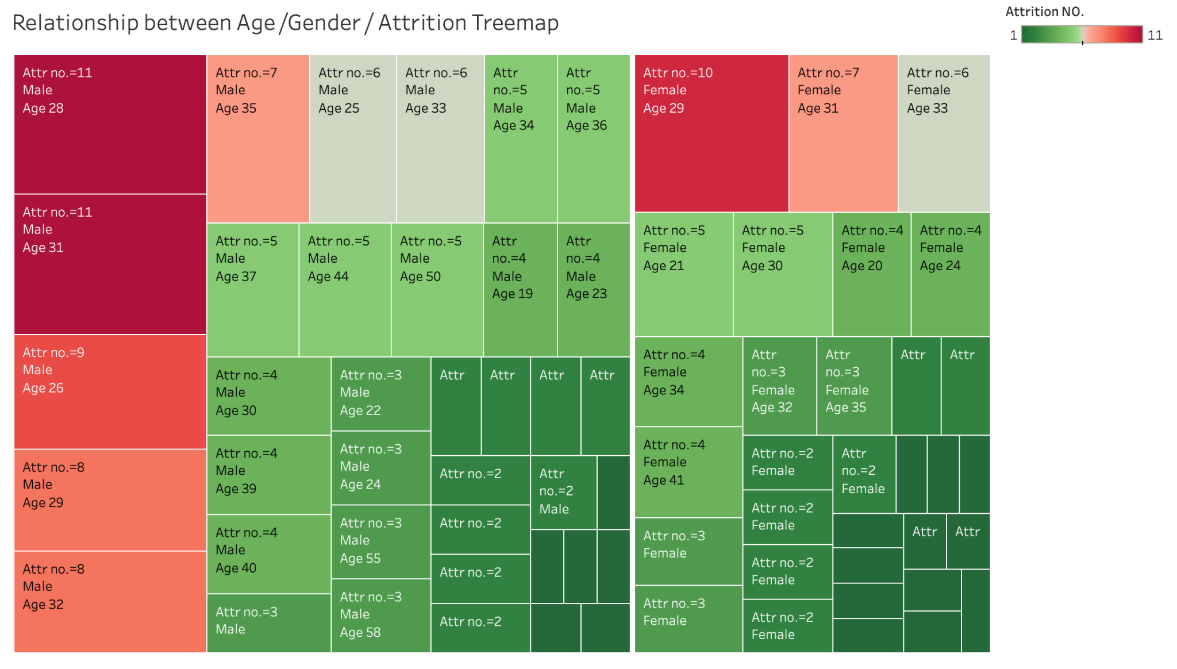

Slide 14
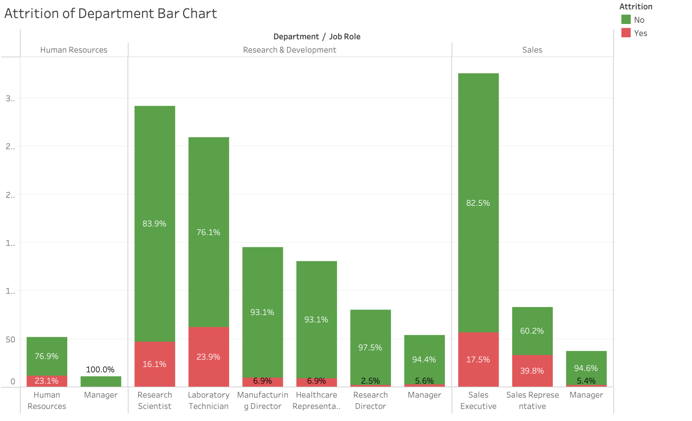

Slide 15
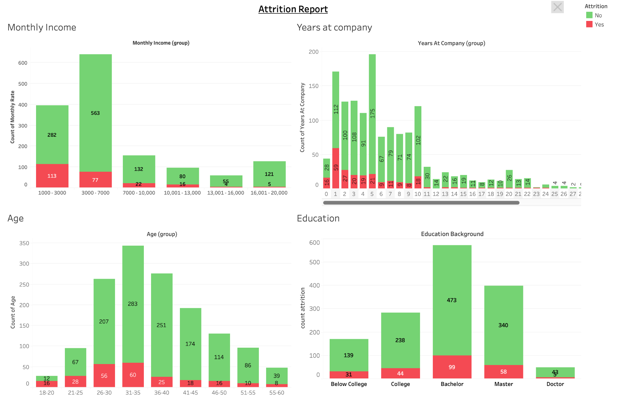

Slide 16
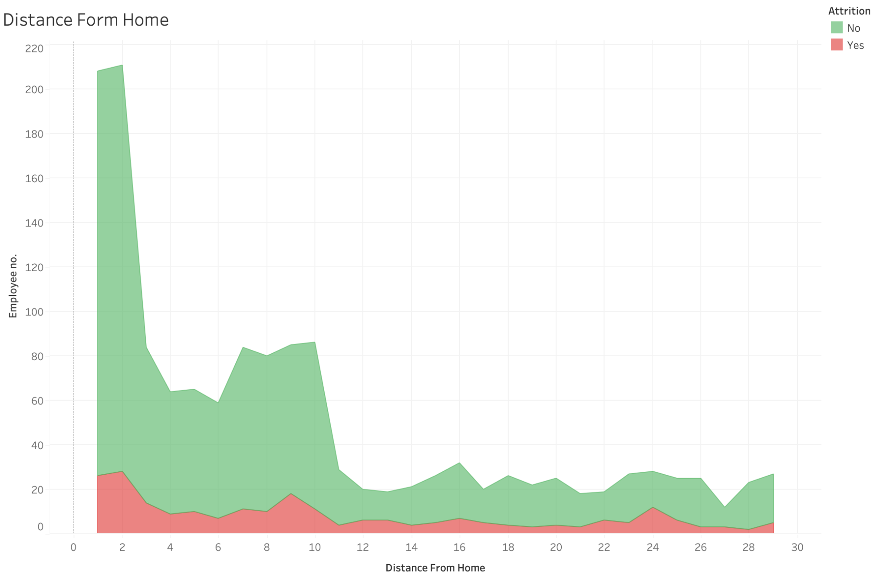

Slide 17
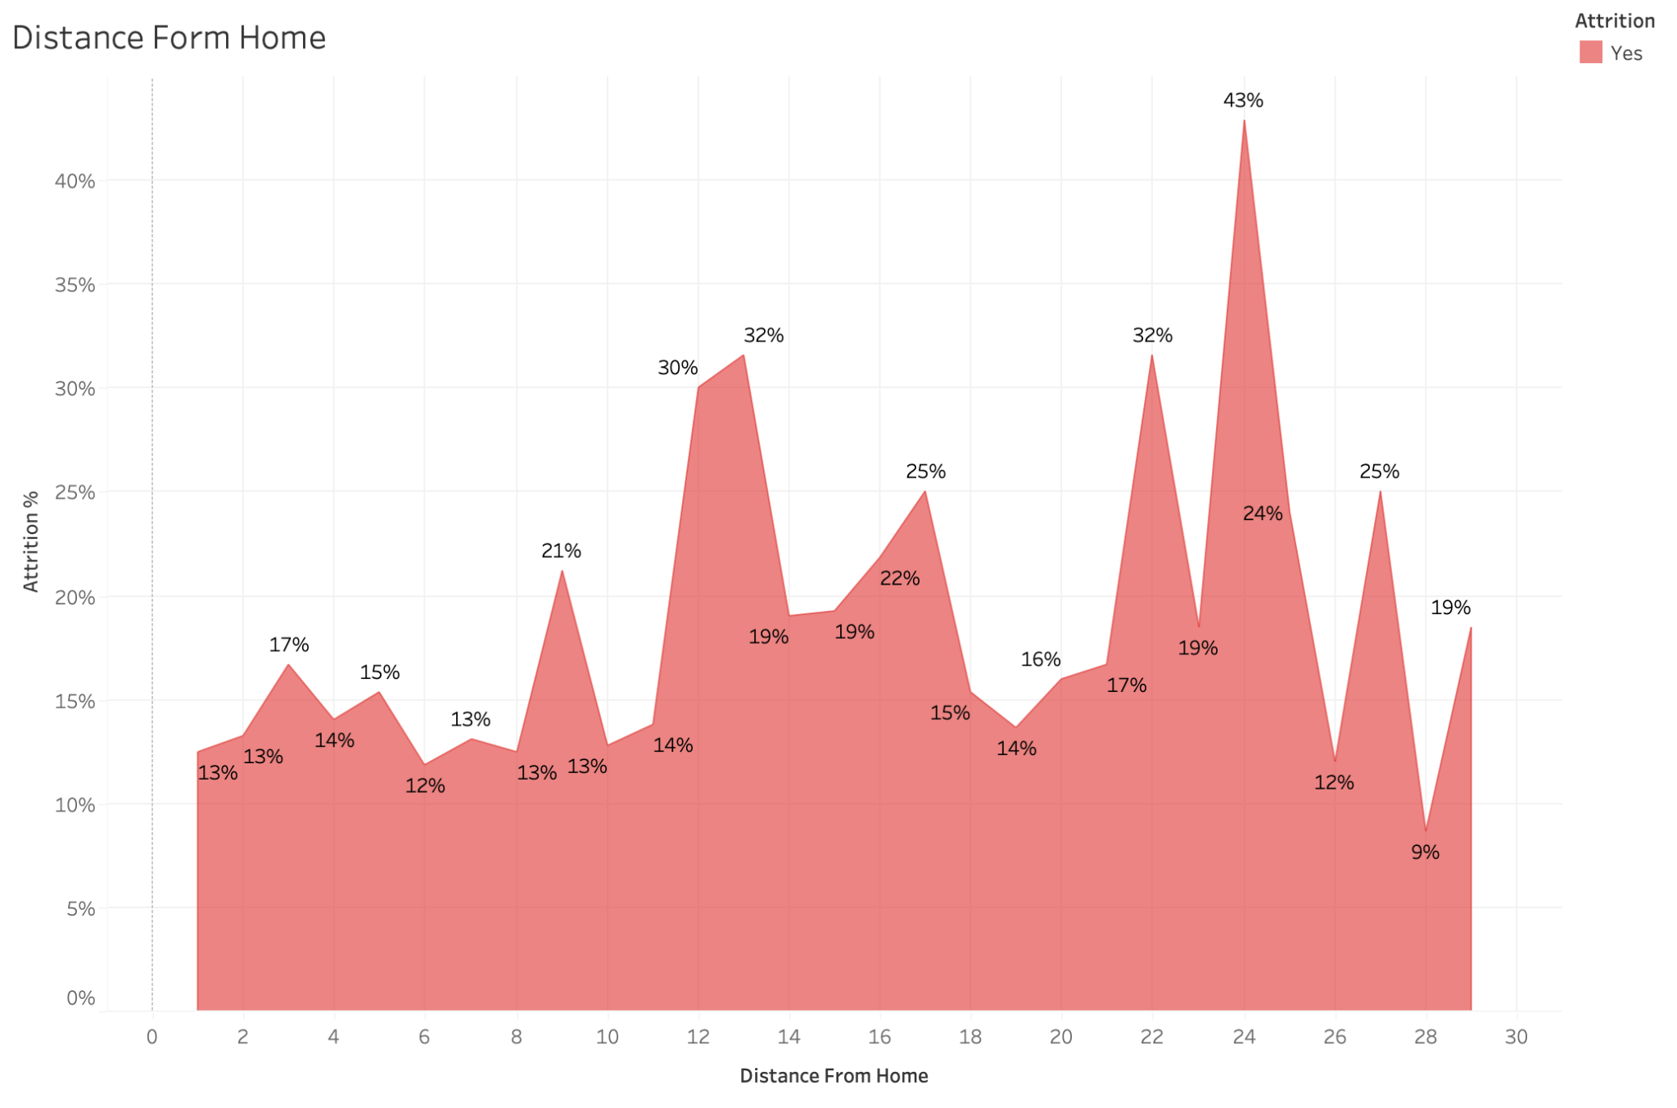

Slide 18
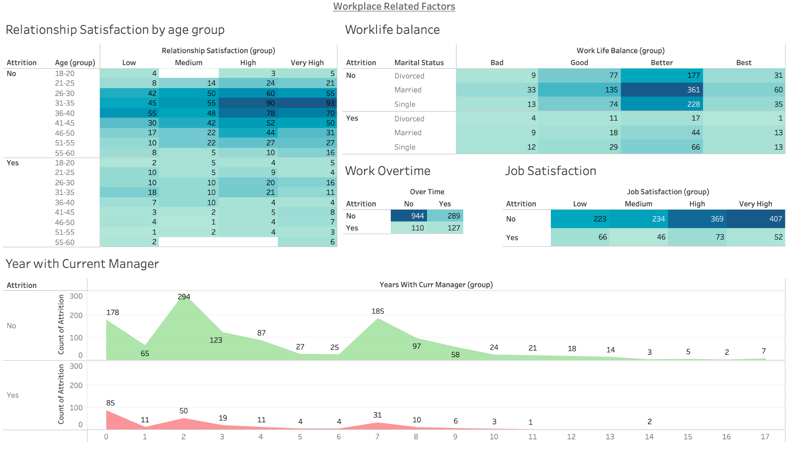

Slide 19


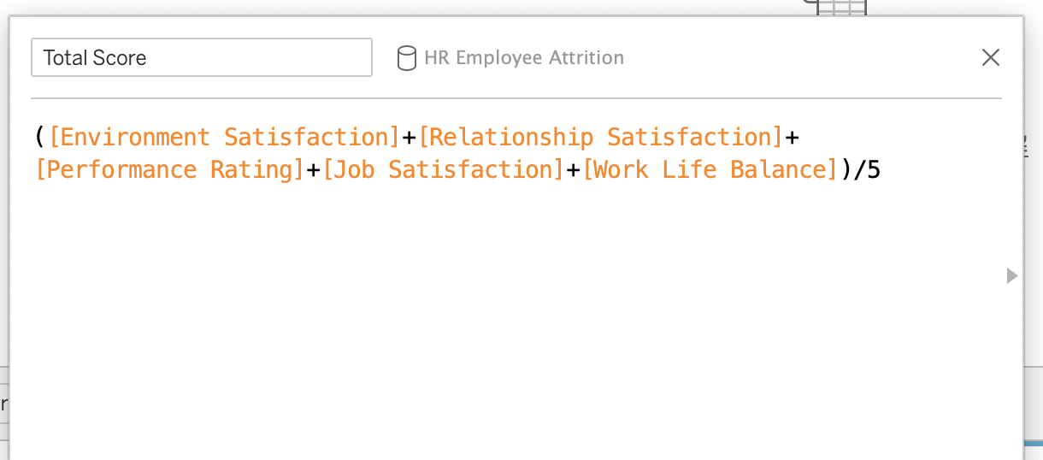


Data Calculate
Total Score

Slide 20
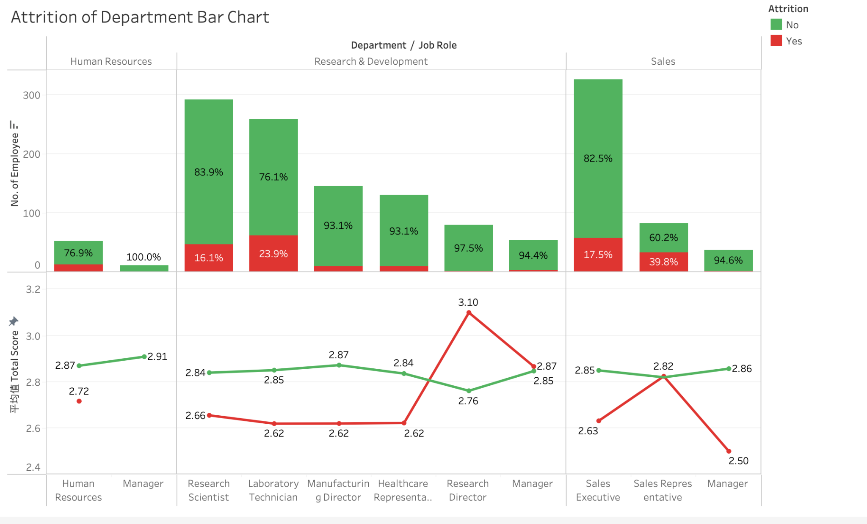

Slide 21
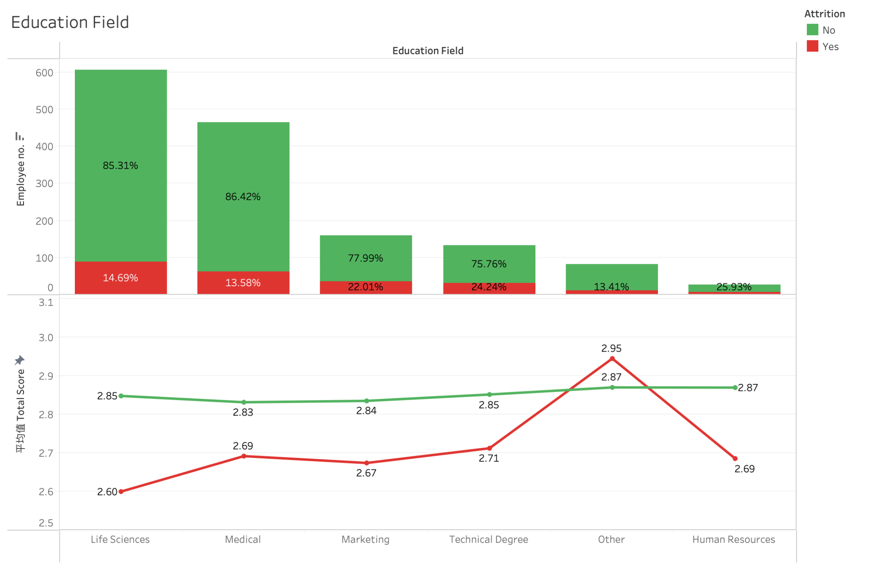

Slide 22
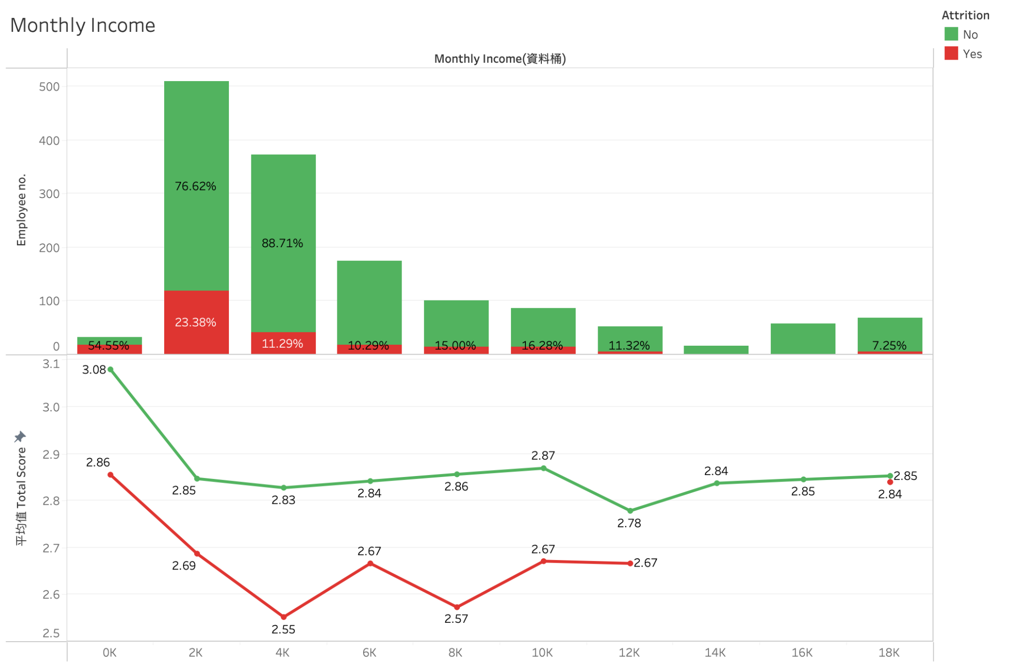

Slide 23
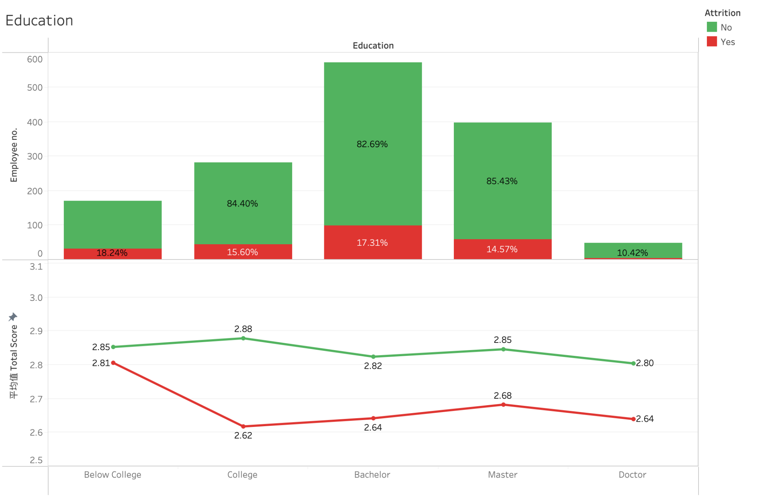

Slide 24
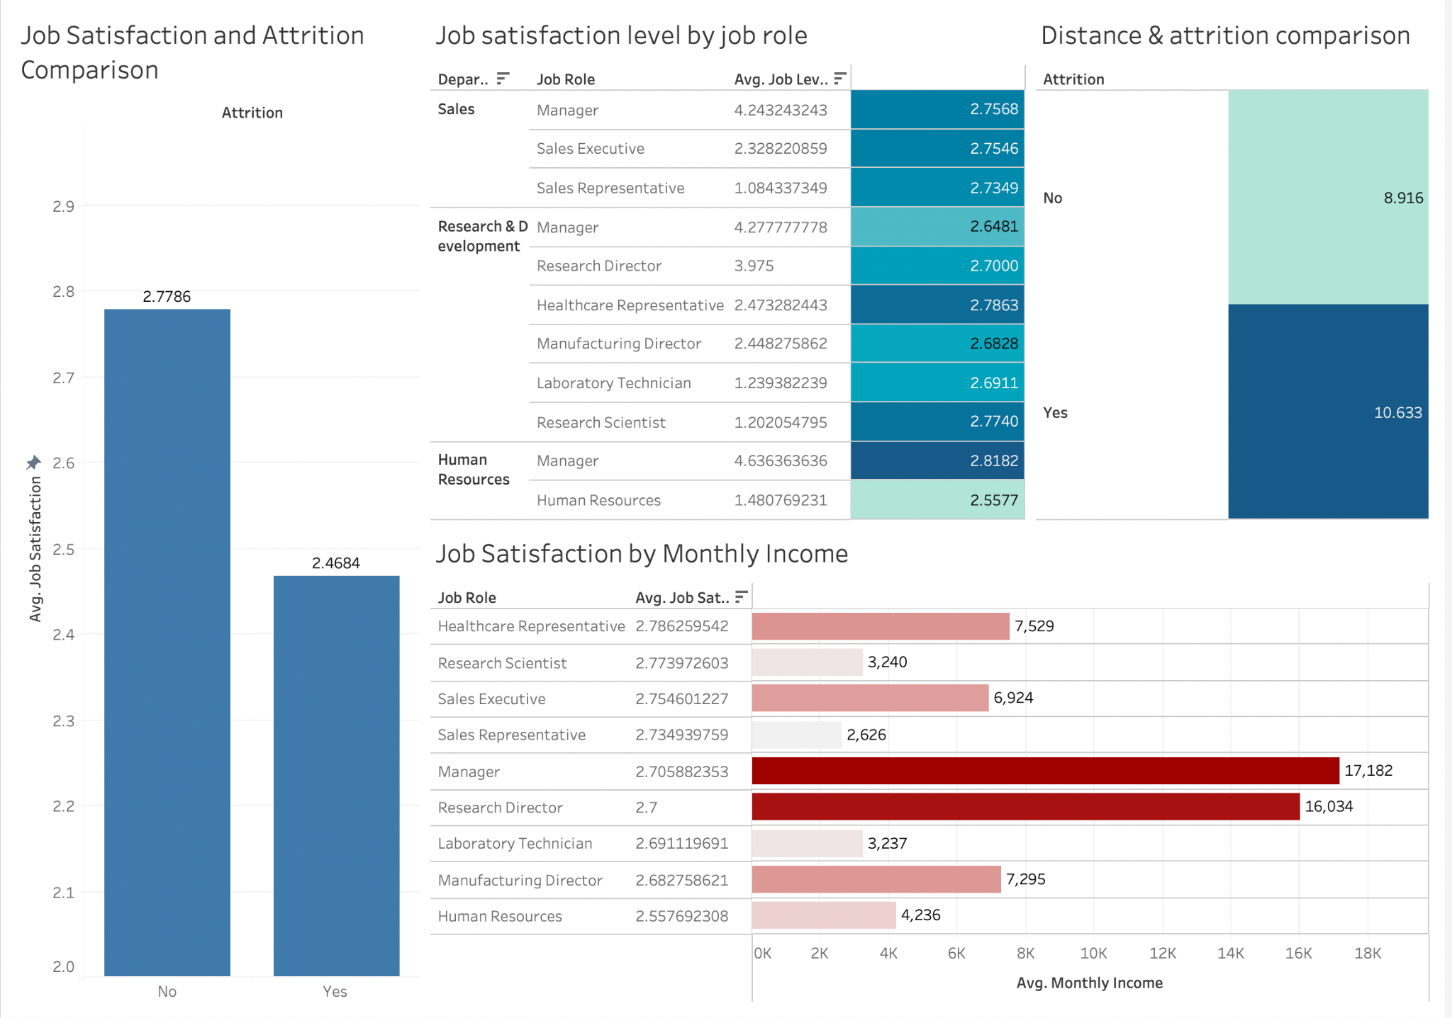

Slide 25
PART 4
4
PART 4
Machine Learning

Slide 26
Logistic Regression
What is logistic regression?
an example of supervised learning.
calculate or predict the probability of a binary (yes/no) event occurring.
classification model.

Slide 27
PART 5
5
PART 5
Conclusion

Slide 28


Conclusion
Conclusion
Findings:
don’t like their boss/manager
received a job offer with a higher salary at another company
unhappy in their current role
want more opportunities to advance their career
lack a good work-life balance
don’t receive enough coaching or feedback

Slide 29

Conclusion
Conclusion
Recommendation :
create a fair pay structure
evaluate incentives
provide opportunities to advance
conduct exit interviews

Slide 30


THANKS
THANKS

